Slide 1
Clustering!

Slide 2
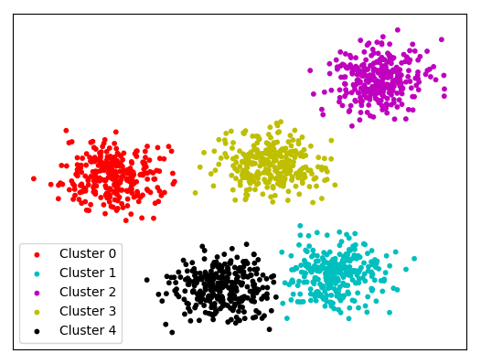

Slide 3
Important Points
Cluster: a collection of data objects
Similar to one another within the same cluster
Dissimilar to the objects in other clusters
Cluster analysis
Grouping a set of data objects into clusters
Clustering is unsupervised classification: no predefined classes
Typical applications
As a stand-alone tool to get insight into data distribution
As a preprocessing step for other algorithms

Slide 4
Why Clustering?
In marketing, customers are segmented according to similarities to carry out targeted marketing.(NetFlix, Amazon, Flipkart, YouTube)
Detecting distinct kinds of pattern in image data (Image processing). It’s effective in biology research for identifying the underlying patterns.
Earth-quake studies: Observed earth quake epicenters should be clustered along continent faults

Slide 5
The K-Means Clustering Method
Given k, the k-means algorithm is implemented in four steps:
- Partition objects into k nonempty subsets
- Compute seed points as the centroids of the clusters of the current partition (the centroid is the center, i.e., mean point, of the cluster)
- Assign each object to the cluster with the nearest seed point
- Go back to Step 2, stop when no more new assignment

Slide 7
Strength: Relatively efficient: O(tkn), where n is # objects, k is # clusters, and t is # iterations. Normally, k, t << n.
Weakness
- Applicable only when mean is defined, then what about categorical data?
- Need to specify k, the number of clusters, in advance
- Unable to handle noisy data and outliers
- Not suitable to discover clusters with non-convex shapes

Slide 8
Hierarchical Clustering
Clusters are created in levels actually creating sets of clusters at each level.
Agglomerative
Initially each item in its own cluster
Iteratively clusters are merged together
Bottom Up
Divisive
Initially all items in one cluster
Large clusters are successively divided
Top Down

Slide 10
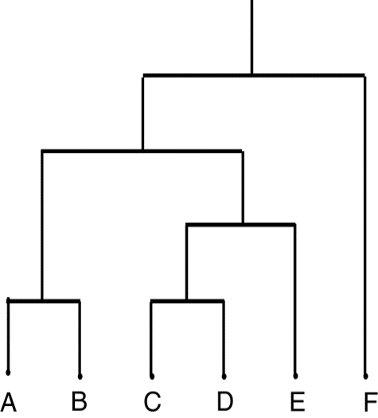
Dendrogram
Dendrogram: a tree data structure which illustrates hierarchical clustering techniques.
Each level shows clusters for that level.
Leaf – individual clusters
Root – one cluster

Slide 11
Distance Between Clusters?
Single Link: smallest distance between points
Complete Link: largest distance between points
Average Link: average distance between points
Centroid: distance between centroids

Slide 12
Let’s Get Coding!

